Slide 1
Orientation / Rotation Matrix
Prepared by:
Engr. Mikko A. De Torres

Slide 3
Position
Position/Displacement Vector
Orientation/Rotation
Orientation/Rotation Matrix

Slide 4
Orientation/Rotation

Slide 5
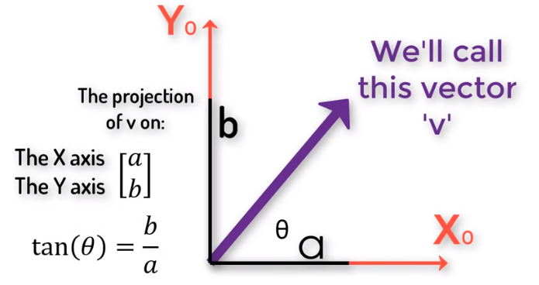
Rotation/Orientation
Projection

Slide 6
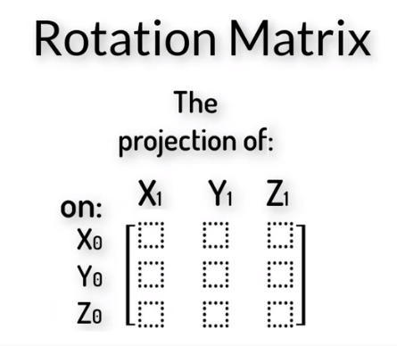
Rotation/Orientation

Slide 7
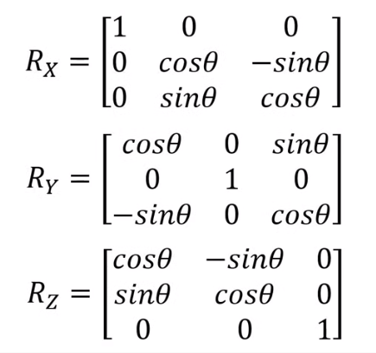
Rotation/Orientation

Slide 8
Rotation/Orientation

